Slide 1
Litter Innovation Fund
As part of the Litter Innovation Fund, funded by DEFRA and managed by Wrap UK, Leicester City Council are conducting a media campaign involving local schools to highlight the issue of litter in Leicester and beyond.
The campaign comprises of a series of short, hard-hitting clips to be used in digital media across the city.
Three key themes which will be addressed;
Litter down drains
Fly-tipping
How litter impacts wildlife

Slide 2
Litter Innovation Fund
The clips have been filmed by a professional film crew and star children from six Leicester Schools
All clips have been subtitled in English and subtitled in the 10 most spoken languages in Leicester: Gujarati, Urdu, Punjabi, Bengali, Somali, Arabic, Farsi, Polish, Slovak and Mandarin
We will be conducting litter surveys, both before and after the campaign, in areas local to schools in order to assess the impact the campaign has

Slide 3
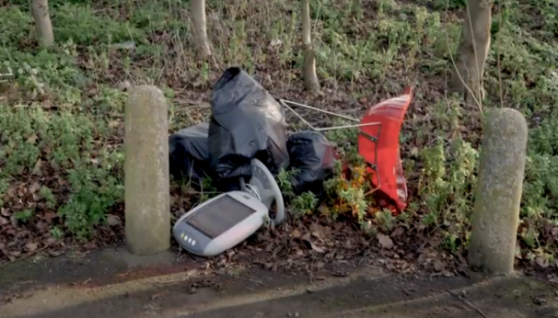
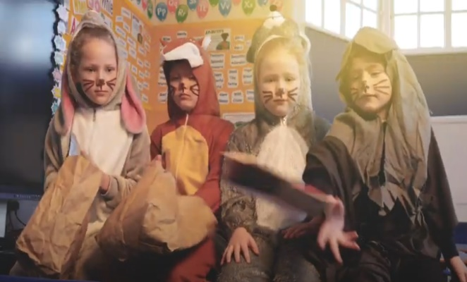
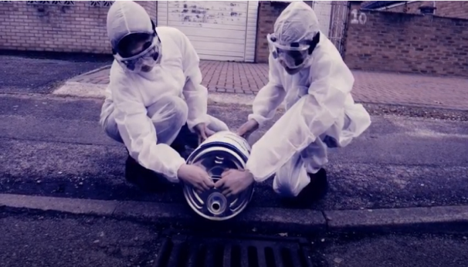
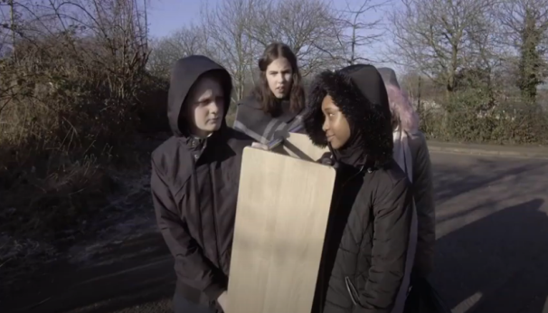
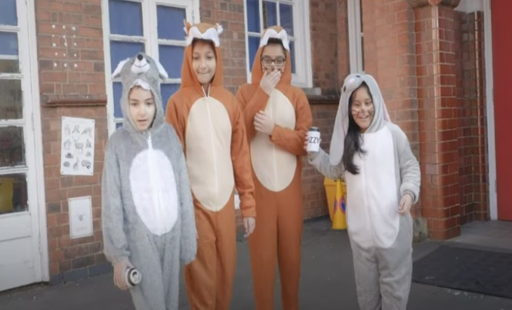
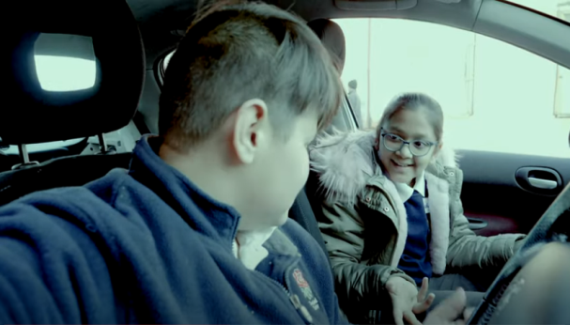
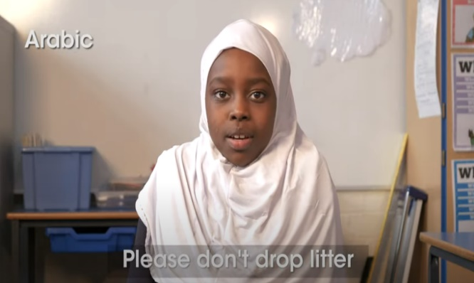
6 Short Film Clips and Multi-language
EcoSchoolsLCC
King Richard III Infant & Nursery School
Shaftesbury Junior School
Rushey Mead Academy
Castle Mead Academy
Rushey Mead Primary School
Catherine Junior School
Love where you live

Slide 4
Campaign posters
Email signature and banner size
9:16 poster size
Digital displays were made in 3 size formats (banner/email signature, A4 ratio and 9:16 widescreen size
A4 poster size

Slide 5
Suitable for banners and email signatures

Slide 6
A4 ratio posters
Suitable for shop fronts and printed display boards

Slide 7
16:9 Ratio posters
Suitable for digital displays in the city centre

Slide 8
Flytipping 1
Please wait a few seconds for film to load before clicking play
Please don't fly tip - Love Where you Live! Dumping waste is dangerous and illegal. Dispose of your waste responsibly. Every year local councils deals with rubbish that is flytipped which costs all of us in the long run. Not only does it look unsightly it can be dangerous - often contains sharp materials or dangerous materials such as asbestos. This video has been produced by the Environmental Education Team at Leicester City Council with funding from The Litter Innovation Fund which is jointly funded by the Department for Environment & Rural Affairs (Defra) and the Ministry of Housing, Communities & Local Government (MHCLG). This film stars students from Castle Mead Academy, Leicester. Further information about our campaign available at https://schools.leicester.gov.uk/litter #LoveWhereYouLive #LitterLessLeicester Original - https://youtu.be/TPubeL1K0PU Arabic - https://youtu.be/m_NAdA5ekdA Bengali - https://youtu.be/nouHRYRTEoE Mandarin - https://youtu.be/ZxfmgLIbpeU Farsi - https://youtu.be/McHM6h58DAo Gujarati - https://youtu.be/TomRQPIBfMc Polish - https://youtu.be/tGj_n2NUHlg Punjabi - https://youtu.be/3Mu-zmqtvxU Slovak - https://youtu.be/VlY6d6T_vNE Somali - https://youtu.be/L3SIVYjN_O0 Urdu - https://youtu.be/Ck-nSLph3EE

Slide 9
Flytipping 2
Please don't fly tip - Love Where you Live! Dumping waste is dangerous and illegal. Dispose of your waste responsibly. Every year local councils deals with rubbish that is flytipped which costs all of us in the long run. Not only does it look unsightly it can be dangerous - often contains sharp materials or dangerous materials such as asbestos. This video has been produced by the Environmental Education Team at Leicester City Council with funding from The Litter Innovation Fund which is jointly funded by the Department for Environment & Rural Affairs (Defra) and the Ministry of Housing, Communities & Local Government (MHCLG). This film stars students from King Richard III Infant and Nursery School, Leicester. Further information about our campaign available at https://schools.leicester.gov.uk/litter #LoveWhereYouLive #LitterLessLeicester Original - https://youtu.be/g3OGge_owKk Arabic - https://youtu.be/RS_y0oAu94I Bengali - https://youtu.be/eCHxOLrlhUY Mandarin - https://youtu.be/FLsPmLMJXKg Farsi - https://youtu.be/-zb-JwoXkEE Gujarati - https://youtu.be/2RtrmdcKr4E Polish - https://youtu.be/_R4hBSUptsg Punjabi - https://youtu.be/-5oU9SXHpxw Slovak - https://youtu.be/DF0efyh9L1M Somali - https://youtu.be/UnKHQplFaxA Urdu - https://youtu.be/3xJ0XaSRXxc

Slide 10
Marine pollution 2
Seas and Rivers Chemical Pollution - Love Where you live! Anything washed down a drain ends up in our rivers and seas. Dispose of your waste responsibly. Not many people know that the sea starts in the streets of our towns. The storm drains run straight into rivers and then into the sea untreated meaning that anything put or washed down them ends up there too. This includes litter and things like engine oil or paint. This video has been produced by the Environmental Education Team at Leicester City Council with funding from The Litter Innovation Fund which is jointly funded by the Department for Environment & Rural Affairs (Defra) and the Ministry of Housing, Communities & Local Government (MHCLG). This video stars students from Rushey Mead Academy, Leicester. Further information available at https://schools.leicester.gov.uk/litter #LoveWhereYouLive #LitterLessLeicester Original - https://youtu.be/5pOvVHEsvrE Arabic - https://youtu.be/H34PHMiQ9wk Bengali - https://youtu.be/Our8uN3BeSY Mandarin - https://youtu.be/nnbL-LZOZWw Farsi - https://youtu.be/T5OH1U47Zww Gujurati - https://youtu.be/3yl-kdWLpTI Polish - https://youtu.be/dATN6h9quP4 Punjabi - https://youtu.be/h0SoL8LK070 Slovak - https://youtu.be/bkxyspaVObQ Somali - https://youtu.be/hUodRCS6zRE Urdu - https://youtu.be/52G3v8c_yEw

Slide 11
Marine pollution 1
Seas and Rivers Plastic Pollution – Love Where you Live! Anything washed down a drain ends up in our rivers and seas. Dispose of your waste responsibly. Not many people know that the sea starts in the streets of our towns. The storm drains run straight into rivers and then into the sea untreated meaning that anything put or washed down them ends up there too. This includes litter and things like engine oil or paint. This video has been produced by the Environmental Education Team at Leicester City Council with funding from The Litter Innovation Fund which is jointly funded by the Department for Environment & Rural Affairs (Defra) and the Ministry of Housing, Communities & Local Government (MHCLG). This video stars students from Catherine Junior School, Leicester. Further information available at https://schools.leicester.gov.uk/litter #LoveWhereYouLive #LitterLessLeicester Original - English - https://youtu.be/Pu4mh8xlNGE Arabic - https://youtu.be/tmvJwa3mU0U Bengali - https://youtu.be/VuaM2fbbO2k Mandarin - https://youtu.be/5FeKE4yxnyQ Farsi - https://youtu.be/phM091gi9Co Gujarati - https://youtu.be/ktSWl0B7ftQ Polish - https://youtu.be/1ueHISKSKi0 Punjabi - https://youtu.be/Qq0B28JdLY0 Slovak - https://youtu.be/XGUH__rukOk Somali - https://youtu.be/UhhtPNp0wy4 Urdu - https://youtu.be/VOs8RC1rNxU

Slide 12
Animals 1
Litter harms animals - Love Where you Live! Litter causes injuries and death to animals. Bin your litter and save wildlife. Every year animal charities report injuries and deaths of wild animals from litter. By putting litter in the bin and disposing of waste correctly we can all ensure that our wildlife remains safe. This video has been produced by the Environmental Education Team at Leicester City Council with funding from The Litter Innovation Fund which is jointly funded by the Department for Environment & Rural Affairs (Defra) and the Ministry of Housing, Communities & Local Government (MHCLG). This video stars students from Rushey Mead Primary School, Leicester. Further information available at https://schools.leicester.gov.uk/litter #LoveWhereYouLive #LitterLessLeicester Original - https://youtu.be/0Mm9yitr3TU Arabic - https://youtu.be/0VAzzPYyvCo Bengali - https://youtu.be/Xb7WZ92khek Mandarin - https://youtu.be/VjqO8zs99m0 Farsi - https://youtu.be/rqlhheVNQsA Gujurati - https://youtu.be/REjDC30sje4 Polish - https://youtu.be/TIGt-MNWofo Punjabi - https://youtu.be/ObIuQoBFTUU Slovak - https://youtu.be/89R0xymBROE Somali - https://youtu.be/ASYkVQDlvz4

Slide 13
Animals 2
Litter harms animals - Love Where you Live! Litter harms animals - Love Where you Live! Animals mistake our litter for food and shelter. Bin your litter and save wildlife. Every year animal charities report injuries and deaths of wild animals from litter. By putting litter in the bin and disposing of waste correctly we can all ensure that our wildlife remains safe. This video has been produced by the Environmental Education Team at Leicester City Council with funding from The Litter Innovation Fund which is jointly funded by the Department for Environment & Rural Affairs (Defra) and the Ministry of Housing, Communities & Local Government (MHCLG). This video stars students from Shaftesbury Junior School, Leicester. Further information available at https://schools.leicester.gov.uk/litter #LoveWhereYouLive #LitterLessLeicester Original - https://youtu.be/J9LPtUmVr84 Arabic - https://youtu.be/c3VTFOAyQgA Bengali - https://youtu.be/ePa8fUhpn6k Mandarin - https://youtu.be/wK90RXwd1Ow Farsi - https://youtu.be/KecBDx7VKxg Gujarati - https://youtu.be/t5983hCjSzw Polish - https://youtu.be/EfWZ4pe_w_o Punjabi - https://youtu.be/0n48ayTeVbc Slovak - https://youtu.be/hc105geHMu0 Somali - https://youtu.be/oAOMOLI3osw Urdu - https://youtu.be/vZB1T-xJkJs

Slide 14
Love where you Live
The children of Leicester have a message for you... Please don't drop litter. Dispose of your waste responsibly. This video has been produced by the Environmental Education Team at Leicester City Council with funding from The Litter Innovation Fund which is jointly funded by the Department for Environment & Rural Affairs (Defra) and the Ministry of Housing, Communities & Local Government (MHCLG) Further information about our campaign available at https://schools.leicester.gov.uk/litter #LoveWhereYouLive #LitterLessLeicester Video 1 - https://youtu.be/Ue6rscsNz7w Video 2 - https://youtu.be/tOoG5RJ9DZ0 Video 3 - https://youtu.be/v0-QPc3u3JE Video 4 https://youtu.be/F1WxcKqXxsc Video 5 https://youtu.be/cCWS8Rr25S4 Video 6 https://youtu.be/9kzHuBWUAKc Video 7 https://youtu.be/piCKTEC8FS8 All languages - https://youtu.be/dwwQW0sHxOw

Slide 15
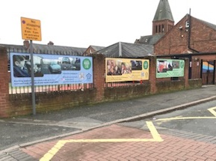
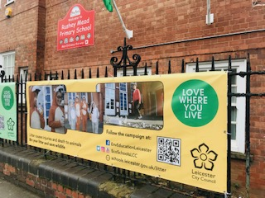
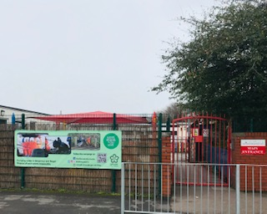
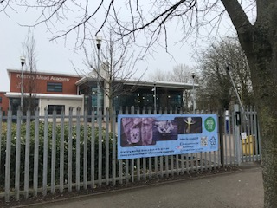
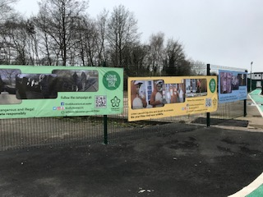
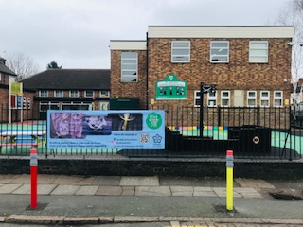
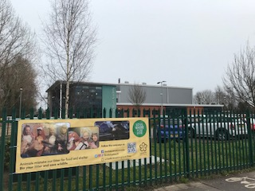
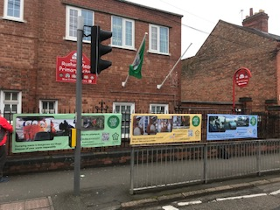
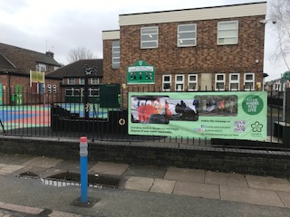
Banners displayed in key areas outside schools

